Slide 1



Department of Computer Science and Engineering, BRAC University
Lecture 2
Binary Codes,
Signed & Unsigned Numbers - 1's & 2's Complement
CSE260 : Digital Logic Design

Slide 2
Binary Coded Decimal (BCD)
Decimal numbers are more natural to humans. Binary numbers are natural to computers. Quite expensive to convert between the two.
If little calculation is involved, we can use some coding schemes for decimal numbers.
One such scheme is BCD, a.k.a the 8421 code.
Represent each decimal digit as a 4-bit binary code.
‹#›
Department of Computer Science and Engineering
CSE260 - Digital Logic Design

Slide 3
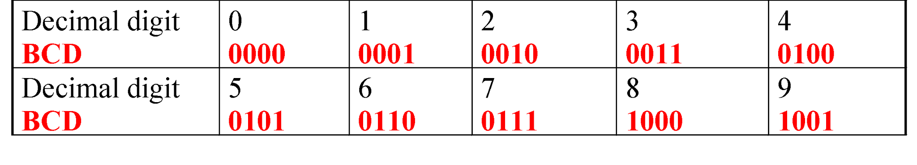
Binary Coded Decimal (BCD)
Also known as the 8421 code.
Represent each decimal digit as a 4-bit binary code.
Some codes are unused, eg: (1010)_{BCD}, (1011) _{BCD}, …, (1111) _{BCD}. These codes are considered as errors.
Easy to convert, but arithmetic operations are more complicated.
Suitable for interfaces such as keypad inputs and digital readouts.
‹#›
Department of Computer Science and Engineering
CSE260 - Digital Logic Design

Slide 4
Binary Coded Decimal (BCD)
Examples:
(234)₁₀ = (0010 0011 0100)_{BCD}
(7093)₁₀ = (0111 0000 1001 0011)_{BCD}
(1000 0110)_{BCD} = (86)₁₀
(1001 0100 0111 0010)_{BCD} = (9472)₁₀
Note: BCD is not equivalent to binary.
Example: (234)₁₀ = (11101010)₂
‹#›
Department of Computer Science and Engineering
CSE260 - Digital Logic Design

Slide 5
Decimal Digit | BCD 8421 | Excess-3
0 | 0000 | 0011
1 | 0001 | 0100
2 | 0010 | 0101
3 | 0011 | 0110
4 | 0100 | 0111
5 | 0101 | 1000
6 | 0110 | 1001
7 | 0111 | 1010
8 | 1000 | 1011
9 | 1001 | 1100
Unused Bit Combi- nations | 1010 | 0000
 | 1011 | 0001
 | 1100 | 0010
 | 1101 | 1101
 | 1110 | 1110
 | 1111 | 1111
Binary Codes
Other Codes:
Excess-3
‹#›
Department of Computer Science and Engineering
CSE260 - Digital Logic Design

Slide 6
Negative Numbers Representation
There are three common ways of representing signed numbers (positive and negative numbers) for binary numbers:
Sign
and
Magnitude
1s Complement
2s Complement
‹#›
Department of Computer Science and Engineering
CSE260 - Digital Logic Design

Slide 7
Sign-and-Magnitude
Negative numbers are usually written by writing a minus sign in front.
Example:
- (12)₁₀ , - (1100)₂
In computer memory of fixed width, this sign is usually represented by a bit:
0 for +
1 for -
‹#›
Department of Computer Science and Engineering
CSE260 - Digital Logic Design

Slide 8
Sign-and-Magnitude [cont.]
Example: an 8-bit number can have 1-bit sign and 7-bits magnitude.
sign
magnitude
‹#›
Department of Computer Science and Engineering
CSE260 - Digital Logic Design

Slide 9
Signed magnitude representation
Examples:
1101₂ = 13₁₀ (a 4-bit unsigned number)
0 1101 = +13₁₀ (a positive number in 5-bit signed magnitude)
1 1101 = -13₁₀ (a negative number in 5-bit signed magnitude)
0100₂ = 4₁₀ (a 4-bit unsigned number)
0 0100 = +4₁₀ (a positive number in 5-bit signed magnitude)
1 0100 = -4₁₀ (a negative number in 5-bit signed magnitude)
‹#›
Department of Computer Science and Engineering
CSE260 - Digital Logic Design

Slide 10
Sign-and-Magnitude [Cont.]
Largest Positive Number: 0 1111111 +(127)₁₀
Largest Negative Number: 1 1111111 -(127)₁₀
Zeroes: 0 0000000 +(0)₁₀
1 0000000 -(0)₁₀
Range: -(127)₁₀ to +(127)₁₀
Signed numbers needed for negative numbers.
Representation: Sign-and-magnitude.
‹#›
Department of Computer Science and Engineering
CSE260 - Digital Logic Design

Slide 11
1s Complement
Given a number x which can be expressed as an n-bit binary number (i.e. integer part has n digits and fraction has m digit), its negative value can be obtained in 1s-complement representation using:
Decimal Digit | 1’s complement
+7 | 0111
+6 | 0110
+5 | 0101
+4 | 0100
+3 | 0011
+2 | 0010
+1 | 0001
+0 | 0000
Decimal Digit | 1’s complement
-7 | 1000
-6 | 1001
-5 | 1010
-4 | 1011
-3 | 1100
-2 | 1101
-1 | 1110
-0 | 1111
‹#›
Department of Computer Science and Engineering
CSE260 - Digital Logic Design

Slide 12
1s Complement [Cont.]
- ( 0 0 0 0 1 1 0 0 )₂
Inverse
( 1 1 1 1 0 0 1 1 )_{1’s}
‹#›
Department of Computer Science and Engineering
CSE260 - Digital Logic Design

Slide 13
1s Complement [Cont.]
Essential technique: invert all the bits.
Examples: 1s complement of 00000001 = (11111110)_{1s}
1s complement of 01111111 = (10000000)_{1s}
Range [in 8 bits]: -(127)₁₀ to +(127)₁₀
General Formula=-(2^{n-1} -1) to + (2^{n-1} -1)
The most significant bit still represents the sign:
0 = +ve; 1 = -ve.
Note: Range for n bit no. is –(2^{(n-1)}-1) to +(2^{(n-1)}-1)
‹#›
Department of Computer Science and Engineering
CSE260 - Digital Logic Design

Slide 14

1s Complement
Example: (assuming 8-bit binary numbers)
(14)₁₀ = (00001110)₂ = (00001110)_{1s}
-(14)₁₀ = -(00001110)₂ = (11110001)_{1s}
-(80)₁₀ = -( ? )₂ = ( ? )_{1s}
‹#›
Department of Computer Science and Engineering
CSE260 - Digital Logic Design

Slide 15
2s Complement
Given a number x which can be expressed as an n-bit (i.e. integer part has n digits and fraction has m digit) number, its negative number can be obtained in 2s-complement representation using:
- x = 2^{n} - x
Example: With an 8-bit number 00001100, its negative value in 2s complement is thus:
-(00001100)₂ = - (12)₁₀
= (2⁸ - 12)₁₀
= (244)₁₀
= (11110100)_{2s}
‹#›
Department of Computer Science and Engineering
CSE260 - Digital Logic Design

Slide 16
2s Complement [cont.]
Method 1: Essential technique: invert all the bits and add 1. Examples: 2s complement of
(00000001)_{2s} = (11111110)_{1s} (invert i.e 1’s complement)
= (11111111)_{2s} (add 1)
2s complement of
(01111110)_{2s} = (10000001)_{1s} (invert i.e 1’s complement)
= (10000010)_{2s} (add 1)
Method 2: Keep unchanged till 1st occurrence of 1 from LSB and invert remaining 1’s into 0’s and 0’s into 1’s till MSB
(01111110)_{2s} = (10000010)_{2s}
Official Method
Unofficial Method
‹#›
Department of Computer Science and Engineering
CSE260 - Digital Logic Design

Slide 17
2s Complement [Cont.]
Range in 8 bits: -(128)₁₀to +(127)₁₀
General Formula= -(2^{n-1}) to + (2^{n-1} -1)
The most significant bit still represents the sign:
0 = +ve; 1 = -ve.
Note: Range for n bit no. is -2^{(n-1)} to +2^{(n-1)}-1
‹#›
Department of Computer Science and Engineering
CSE260 - Digital Logic Design

Slide 18
2s Complement
Example: (assuming 8-bit binary numbers)
(14)₁₀ = (00001110)₂ = (00001110)_{2s}
-(14)₁₀ = -(00001110)₂ = (11110010)_{2s}
-(80)₁₀ = -( ? )₂ = ( ? )_{2s}
‹#›
Department of Computer Science and Engineering
CSE260 - Digital Logic Design

Slide 19
Comparisons of three methods
Example: 4-bit signed number (Positive Values)
Values | Sign and Magnitude | 1’s Complement | 2’s Complement
+7 | 0111 | 0111 | 0111
+6 | 0110 | 0110 | 0110
+5 | 0101 | 0101 | 0101
+4 | 0100 | 0100 | 0100
+3 | 0011 | 0011 | 0011
+2 | 0010 | 0010 | 0010
+1 | 0001 | 0001 | 0001
+0 | 0000 | 0000 | 0000
Note: Signed magnitude cannot be used for arithmetic calculations
‹#›
Department of Computer Science and Engineering
CSE260 - Digital Logic Design

Slide 20
Comparisons of three methods
Example: 4-bit signed number (Negative Values)
Values | Sign and Magnitude | 1’s Complement | 2’s Complement
-0 | 1000 | 1111 | 0000
-1 | 1001 | 1110 | 1111
-2 | 1010 | 1101 | 1110
-3 | 1011 | 1100 | 1101
-4 | 1100 | 1011 | 1100
-5 | 1101 | 1010 | 1011
-6 | 1110 | 1001 | 1010
-7 | 1111 | 1000 | 1001
-8 | - | - | 1000
Note: Signed magnitude cannot be used for arithmetic calculations
‹#›
Department of Computer Science and Engineering
CSE260 - Digital Logic Design

Slide 21
Exercise
1. For 2’s complement binary numbers, the range of values for 5-bit numbers is
a. 0 to 31 b. -8 to +7 c. -8 to +8
d. -15 to +15 e. -16 to +15
2. In a 6-bit 2’s complement binary number system, what is the decimal value represented by (100100)_{2s}?
a. -4 b. 36 c. -36 d. -27 e. -28
3. Following numbers are in 1’s complement system. Turn them to their no. negative representation
A. 1010101 B. 0111000 C. 0000001 D. 00000
4. Now perform 2’s complement
‹#›
Department of Computer Science and Engineering
CSE260 - Digital Logic Design

Slide 22
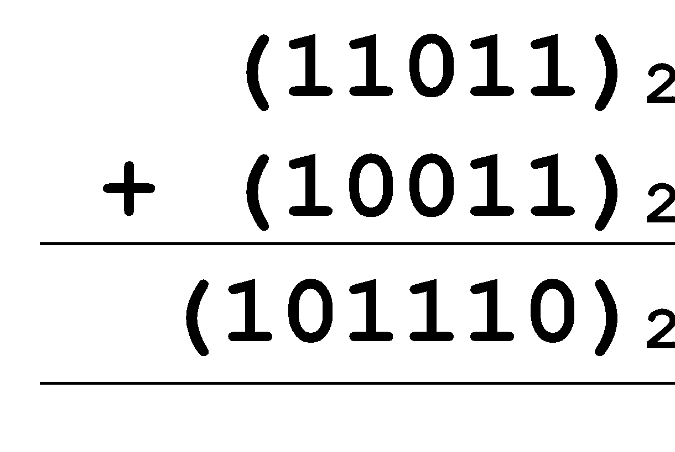
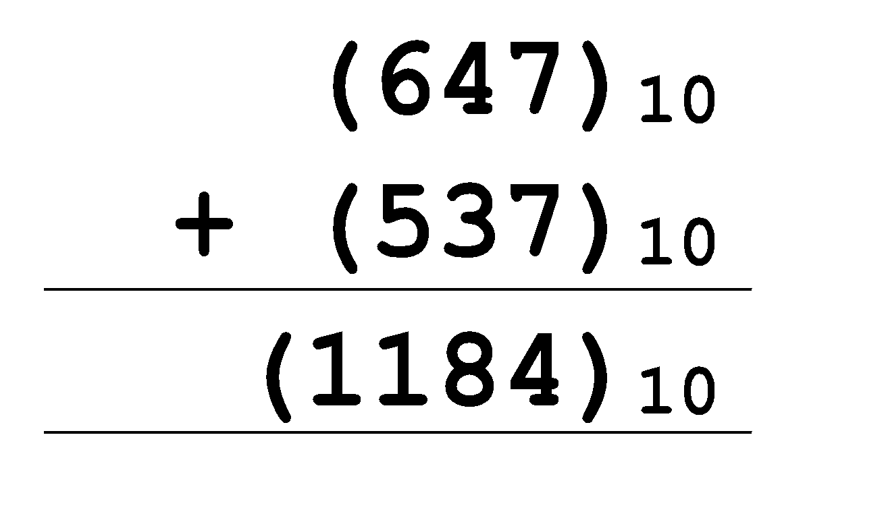
UNSIGNED NO. ARITHMETIC OPERATION!
Binary Arithmetic Operations for Unsigned numbers
ADDITION
Like decimal numbers, two numbers can be added by adding each pair of digits together with carry propagation.
‹#›
Department of Computer Science and Engineering
CSE260 - Digital Logic Design

Slide 23
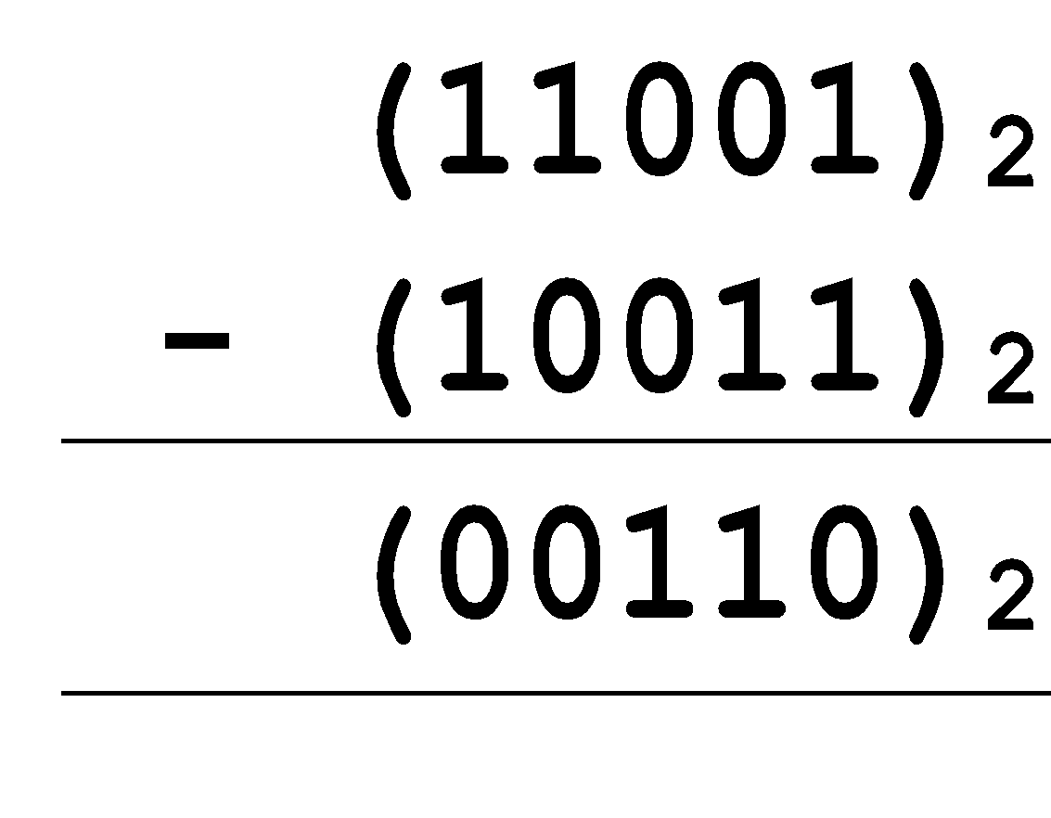
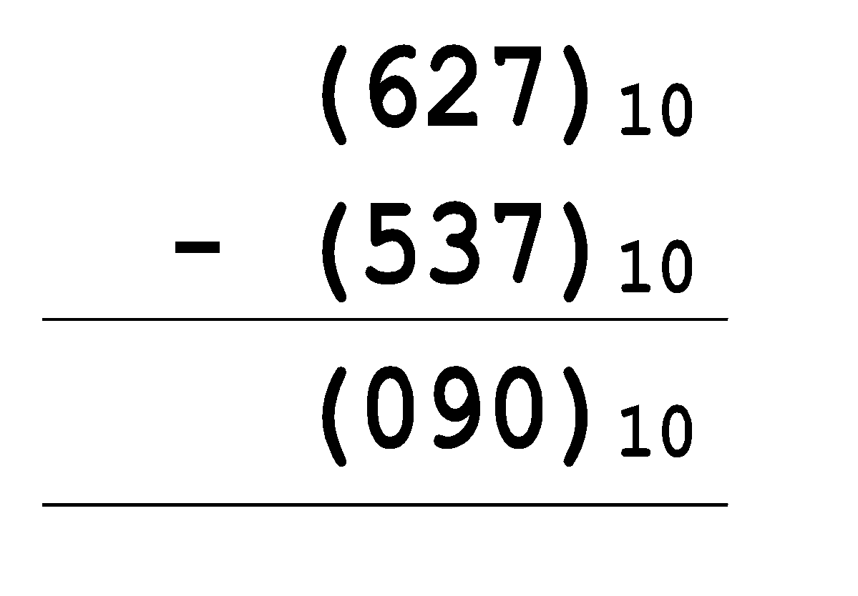
UNSIGNED NO. ARITHMETIC OPERATION!
Binary Arithmetic Operations for Unsigned numbers
SUBTRACTION
Two numbers can be subtracted by subtracting each pair of digits together with borrowing, where needed.
‹#›
Department of Computer Science and Engineering
CSE260 - Digital Logic Design

Slide 24
Overflow
Arithmetic Overflow happens in signed arithmetic when the result is too big or too small to fit in the available bits, causing wrong answers and mistakes in the sign of the number.
‹#›
Department of Computer Science and Engineering
CSE260 - Digital Logic Design

Slide 25
Overflow Detection Rules
Rule-1: Add two same signed numbers
if (result also has the same sign):
No Overflow;
else:
Overflow;
Rule-2: Sub two same signed Numbers:
Never Overflow;
Rule-3: Add two different signed Numbers:
Never Overflow;
Rule-4: Sub two different numbers:
Case-1: +A - (-B) = +A + (+B) => Follow Rule-1
Case-2: -A - (+B) = -A + (-B) => Follow Rule-1
‹#›
Department of Computer Science and Engineering
CSE260 - Digital Logic Design

Slide 26
ARITHMETIC OPERATIONS
ON SIGNED NUMBER
‹#›
Department of Computer Science and Engineering
CSE260 - Digital Logic Design

Slide 27
2s Complement Addition/Subtraction
Algorithm for addition, A + B:
Perform binary addition on the two numbers.
Ignore the carry out of the MSB (most significant bit).
Check for overflow: Overflow occurs if the ‘carry in’ and ‘carry out’ of the MSB are different, or if result is opposite sign of A and B.
Algorithm for subtraction, A – B:
A – B = A + (–B)
Take 2s complement of B by inverting all the bits and adding 1.
Add the 2s complement of B to A.
‹#›
Department of Computer Science and Engineering
CSE260 - Digital Logic Design

Slide 28

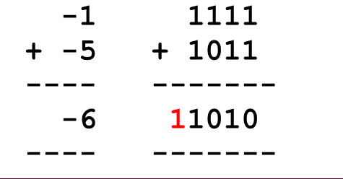
2s Complement Addition/Subtraction
Example: in a 4-bit binary system
Which of the above is/are overflow(s)?
+3 0011
+ +4 + 0100
---- -------
+7 0111
---- -------
+6 0110
+ -3 + 1101
---- -------
+3 10011
---- -------
+4 0100
+ -7 + 1001
---- -------
-3 1101
---- -------
‹#›
Department of Computer Science and Engineering
CSE260 - Digital Logic Design

Slide 29
2s Complement Addition/Subtraction
Example: in a 4-bit binary system
Which of the above is/are overflow(s)?
-3 1101
+ -6 + 1010
---- -------
-9 10111
---- -------
+5 0101
+ +6 + 0110
---- -------
+11 1011
---- -------
‹#›
Department of Computer Science and Engineering
CSE260 - Digital Logic Design

Slide 30
1s Complement Addition/Subtraction
Algorithm for addition, A + B:
Perform binary addition on the two numbers.
If there is a carry out of the MSB, add 1 to the result.
Check for overflow: Overflow occurs if result is opposite sign of A and B.
Algorithm for subtraction, A – B:
A – B = A + (–B)
Take 1s complement of B by inverting all the bits.
Add the 1s complement of B to A.
‹#›
Department of Computer Science and Engineering
CSE260 - Digital Logic Design

Slide 31
1s Complement Addition/Subtraction
Example: in a 4-bit binary system
+3 0011
+ +4 + 0100
---- -------
+7 0111
---- -------
+5 0101
+ -5 + 1010
---- -------
-0 1111
---- -------
-2 1101
+ -5 + 1010
---- ------
-7 10111
---- + 1
------
1000
-3 1100
+ -7 + 1000
---- -------
-10 10100
---- + 1
-------
0101
‹#›
Department of Computer Science and Engineering
CSE260 - Digital Logic Design

Slide 32
Sample Math:
Add -3 with -6 in 6 bits using 2’s complement number system and justify whether there is overflow or not.
Solution:
Unsigned 3 = 11
+3 = 011
+3 in 6 bits = 000011
To get -3 in binary, we need to calculate 2’s complement.
So, 111100 (1’s complement)
+1 (Adding 1)
____________________________
-3 in 6 bits = 111101 (2’s complement)
-------- (1)
Unsigned 6 = 110
+6 = 0110
+6 in 6 bits = 000110
To get -6 in binary, we need to calculate 2’s complement.
So, 111001 (1’s complement)
+1 (Adding 1)
____________________________
-6 in 6 bits = 111010 (2’s complement)
-------- (2)
‹#›
Department of Computer Science and Engineering
CSE260 - Digital Logic Design

Slide 33
Sample Math [Cont.]:
Add -3 with -6 in 6 bits using 2’s complement number system and justify whether there is overflow or not [cont.]
Now, adding (1) and (2),
111101
111010
_______
1 110111
Ignoring the carry, final result is 110111
Here, we are adding two negative numbers and the result is also a negative number. Hence, there is no overflow.
‹#›
Department of Computer Science and Engineering
CSE260 - Digital Logic Design

